Slide 1
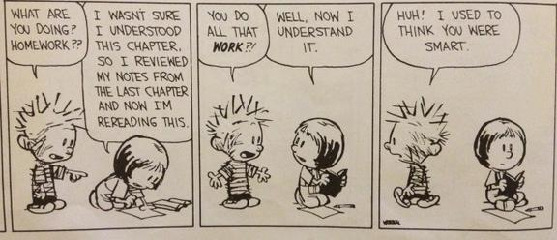
What are Mindsets?
How can I change the way I think to be more successful?

Slide 2
First, a story!
When Carol Dweck was a young researcher, she conducted a study with elementary-aged children like you. She brought them one by one to a room in a school and gave them a series of puzzles to solve. The first ones were fairly easy, but the next ones were hard. As the students struggled to solve the difficult ones, Carol Dweck watched the strategies they used and asked them to tell her about what they were thinking and feeling. What do you think she saw? How do you think the children reacted to the difficult puzzles?
She saw a variety of responses. One boy, upon seeing the difficult puzzle, pulled his chair up, rubbed his hands together, smacked his lips, and said, “I love a challenge!” Another child, sweating as he looked up at the hard puzzles, refused to even try the challenging puzzles.
Which response do you think YOU would have had?
These children exemplify the two mindsets. Let’s take a look at each closely…

Slide 3
What are mindsets?
A MINDSET is a combination of beliefs that influence how we see ourselves as learners and individuals.
There are two mindsets:
Fixed
Growth
BUT mindsets can be changed. (more on this later!)
Mindsets can empower learning and success in dramatic ways.
Think-Pair-Share: How can what you think influence what you can do? Provide an example (HINT: sports, trying new things, at school, etc.)

Slide 4
What is the fixed mindset?
People with the fixed mindset believe their intelligence and other qualities are FIXED.
In other words, your qualities are carved in stone and they cannot change no matter what you do.
If you have a FIXED MINDSET, you…
Believe your intelligence and personality traits cannot change
Think hard work and effort show you are not smart; being smart means everything comes easily without much work
Are afraid of failure and making mistakes because it is proof that you are not smart
Feel an urgency to prove yourself over and over, even when you are achieving amazing things
Constantly feel concerned about how you will be judged
Shy away from trying new things and challenges
Give up easily when you are faced with difficulties or setbacks

Slide 5
Class discussion
How does someone in the fixed mindset view intelligence? To them, what does it mean to be smart?
What role does EFFORT play in the fixed mindset?
Think-Pair-Share: You bombed an important math test and now you have a C in math. You are disappointed because you thought you studied hard and were prepared for the test. In the FIXED MINDSET, what would you reaction be? What would you think about your intelligence and your efforts?

Slide 6
What is the Growth mindset?
People with the growth mindset believe their intelligence and other qualities can be CHANGED and IMPROVED through hard work and by learning from mistakes.
If you have a GROWTH mindset, you…
Believe the intelligence you are born with is just a starting point; you can be smarter if you put in the effort
Have a passion for stretching your mind, trying new things, and challenging yourself (even when your efforts are not going well)
See mistakes NOT as failures and a sign to give up, but rather as a sign to change strategies and work harder
Do not compare yourself to others; instead, you are constantly trying to improve yourself
Believe mistakes and failures DO NOT define you, bur rather are an opportunity to grow
Credit success to effort and hard work
Learn from criticism and feedback

Slide 7
Class discussion
How does someone in the fixed mindset view intelligence? What does it mean to be smart?
What role does EFFORT have in the growth mindset?
Think-Pair-Share: You bombed an important math test and now you have a C in math. You are disappointed because you thought you studied hard and were prepared for the test. In the GROWTH MINDSET, what would you reaction be? What would you think about your intelligence and your efforts? What would you do in preparation for the next math test?

Slide 8
Is a test score forever?
Carol Dweck and her research team showed 5th graders a cardboard box and told them there was a test inside it that measured an “important school ability.” They told them nothing more.
Then they asked:
“How much do you think this test measures an important school ability?”
“Do you think this test measures how smart you are?”
“Do you think this test measures how smart you’ll be when you grow up?”
Think-Pair-Share: How do you think 5th graders in the FIXED mindset responded? In the GROWTH mindset?
FIXED: strongly believed the test measured how smart they are now AND how smart they’d be when they grow up.
GROWTH: believed it measured an important school ability, but that there is no way this ONE test could measure how overall smart they were.
What would YOUR response have been? What does that tell you about your mindset?

Slide 9
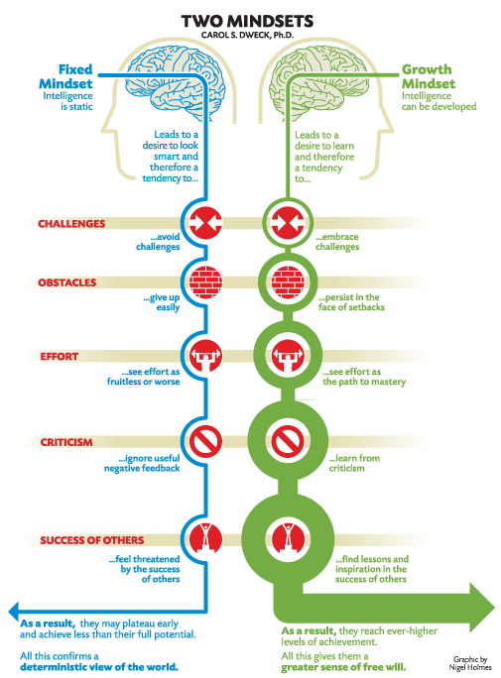
The two mindsets T-Chart
Working with your partner, use the diagram and the information you have learned to complete the Mindsets T-Chart.
Each side should contain information related to each mindset belief on:
Challenges
What to do when faced with obstacles
Effort
Criticism
Self-worth, especially through failures

Slide 10
Which mindset do you have?
Intelligence and personality mindsets

Slide 11
Mindset quiz instructions
Materials needed: whiteboard, dry erase marker/crayon, sock/eraser.
On your whiteboard, write the numbers 1 through 8.
After reading each statement carefully, write either TRUE or FALSE according to whether or not YOU agree or disagree with the statement.
Keep your responses private until we discuss the results after the quiz.

Slide 12
Which mindset do you have about intelligence?
Your intelligence is something very basic about you that you cannot change very much.
No matter how intelligence you have, you can always change it a bit.
You can learn new things, but you can’t really change how intelligent you are.
You can always substantially change how intelligent you are.

Slide 13
Which mindset do you have about Personality?
You are a certain kind of person, and there is not much that can be done to change that.
No matter what kind of person you are, you can always change substantially.
You can always change basic things about the kind of person you are.
You can do things differently, but the important parts of who you are can’t really be changed.

Slide 14
INTELLIGENCE AND MINDSET ANSWERS
Your intelligence is something very basic about you that you cannot change very much.
No matter how intelligence you have, you can always change it a bit.
You can learn new things, but you can’t really change how intelligent you are.
You can always substantially change how intelligent you are.
FIXED
GROWTH
FIXED
GROWTH

Slide 15
PERSONALITY AND MINDSET ANSWERS
You are a certain kind of person, and there is not much that can be done to change that.
No matter what kind of person you are, you can always change substantially.
You can always change basic things about the kind of person you are.
You can do things differently, but the important parts of who you are can’t really be changed.
FIXED
GROWTH
GROWTH
FIXED

Slide 16
Quiz debrief
With your partner, discuss the following questions. Be prepared to share responses with the class.
Which mindset do YOU have about personality? About intelligence?
Are you happy with the mindset you have? Why or why not?
Do you think it’s possible to change your mindset? How?
How does your mindset impact your ability to learn?

Slide 17
OK, I got it…but so what?
YOUR MINDSET is the key to unlocking your learning potential!
A fixed mindset makes you a NON-LEARNER because you are afraid of appearing dumb and making mistakes. You are constantly worried about proving you’re smart, meaning it is difficult to learn.
A growth mindset makes you a LEARNER because you believe you can keep getting smarter through hard work and concentrated effort. You view mistakes and setbacks as an opportunity to grow.
Think-Pair-Share: How do mindsets relate to the end-of-term grades you receive? If you get an A in every subject, does that show anything about the effort you put in to achieve those grades? How about your intelligence?
Be prepared to explain your answer with the class.
REMINDER:
Growth mindset: Success is about learning and effort.
Fixed mindset: Success is about proving you’re smart without trying hard.

Slide 18
How can I change my mindset?
It’s very simple:
CHANGE YOUR WORDS,
CHANGE YOUR MINDSET!
Whatever you choose to think and believe about yourself comes true for you. If you make an effort to change the way you think about yourself, it will become true!

Slide 19
Change your words, change your mindset!
Instead of saying… | Try…
I don’t understand. | What am I missing?
I’m not good at this. | It’s better to know how to learn than to know.
I made a mistake. | Mistakes help me improve.
This is too hard. | This may take time and effort.
I can’t make it any better. | I can always improve. I’ll keep trying.
It’s good enough. | Is this really my best work?
I’ll never be that smart. | I’m going to figure out how to be better.
I’ll give up. | I’ll use some of the strategies I’ve learned and try again.

Slide 20
Let’s practice
Imagine you are trying out for the junior high basketball team. You have been playing since you were 5 and everyone always tells you how talented you are. You show up for tryouts believing your spot on the team is guaranteed, so you don’t work as hard as you possibly could because you don’t want to seem like you’re trying too much. Two days later, the team rosters are released and you are not on it. You are angry and hurt. You think, “I suck at basketball. I’m never going to play again.”
Think-Pair-Share: How can we change your words to change your mindset? What would your next actions be?

Slide 21
Let’s practice
You are preparing to play piano at the school-wide talent show. The pressure is overwhelming. You want to do well so your parents and teachers are proud of you and because you know all of your friends will be watching and judging you based on how well you play. You practice at home occasionally, but you brag to your friends that you don’t need to practice very much – you are THAT good. At the talent show, you do a great job on the song, but you make a minor error at the end of the song and the whole school hears it. You are mortified and embarrassed by the mistake. You run off the stage as the audience politely claps and when your friends try to congratulate you on your performance, you ignore them. You think, “I messed up. It wasn’t perfect. I’m going to stick with the songs I already know I can play well next time so that I don’t make a mistake again.”
Think-Pair-Share: How can we change your words to change your mindset? What would your next actions be?

Slide 22
Let’s get to work!
This year, we will focus as a school on changing our mindsets to exemplify the GROWTH MINDSET.
Code words in Room 12:
Fixed
Change your thoughts, ASAP! You might be showing characteristics of a fixed mindset that are stopping you from learning and growing.
Growth
Way to work! You are showing characteristics of a hard-working, growth-minded scholar. Keep it up!
Effort/Work
Ask yourself, “Is this really my best work? Did I try everything I could to be successful?” It can be frustrating and difficult, but the only way to truly be in the growth mindset is to give your best effort.
Mistakes are awesome!
Mistakes are an opportunity to learn. We celebrate mistakes as an attempt to learn, understand WHY we made the mistake, and TRY AGAIN using the information we gained.
WE NEVER GIVE UP!

Slide 23
reflection journal entry
In your journal, create a new entry titled The Mindsets and be sure to write the date.
Answer the following questions using complete sentences:
What is your mindset on personality? On Intelligence?
Are you happy with the mindset you have right now? Why or why not?
In what ways can you change the way you think and act in school to exemplify the growth mindset?
How can you help friends in your classes or family members think and behave in the growth mindset?
How can the growth mindset help you learn more and be successful outside of school?

